Slide 1
Litigation Validity:
An Ensemble Analysis of 9 States in Litigation
Anne Friedman and Elena Miller

Slide 2
Intro to project
There are 9 U.S. states with congressional maps in litigation.
Congressional redistricting maps are drawn after each census and are used to elect U.S. House of Representatives every 2 years.

Slide 3
States in Question
(2024 Election Results)
 | Districts | Republican Seats | Democrat Seats
Alabama | 7 | 5 | 2
Georgia | 14 | 9 | 5
Arkansas | 4 | 4 | 0
Texas | 38 | 25 | 13
Florida | 28 | 20 | 8
Utah | 4 | 4 | 0
Louisiana | 6 | 4 | 2
South Carolina | 7 | 6 | 1
North Carolina | 14 | 10 | 4

Slide 4
How did the 9 States affect the distribution of the U.S. House?

Slide 5
2024 U.S. House Election
Republicans hold majority (a party needs 218 seats):
Republicans won 220 seats
Democrats won 215 seats
Notes:
Need 218 for a majority

Slide 6
Alabama

Slide 7
Alabama
Original plan had one black-majority district
Was sued and ordered to create a plan with two black-majority districts
Alabama did not successfully form a new plan, so the Court created a temporary plan to be used in the 2024 Election

Slide 8
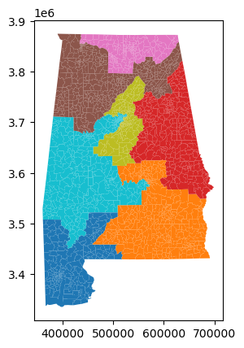
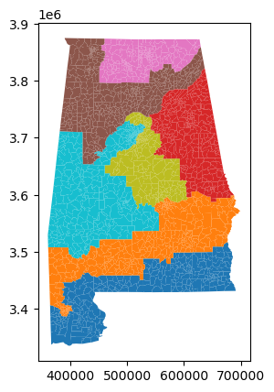
Original Plan
Court-Ordered Plan

Slide 9
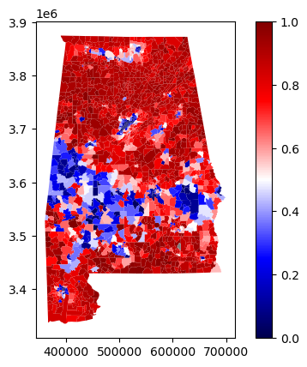
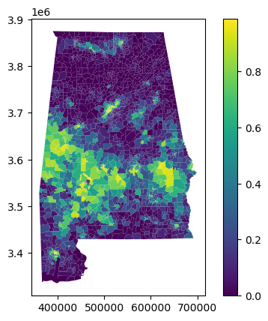
Black Population Percentage by Precinct (2020 Census)
Democrat/Republican Voting Percentage by Precinct
(in 2022 Senate Election)

Slide 10
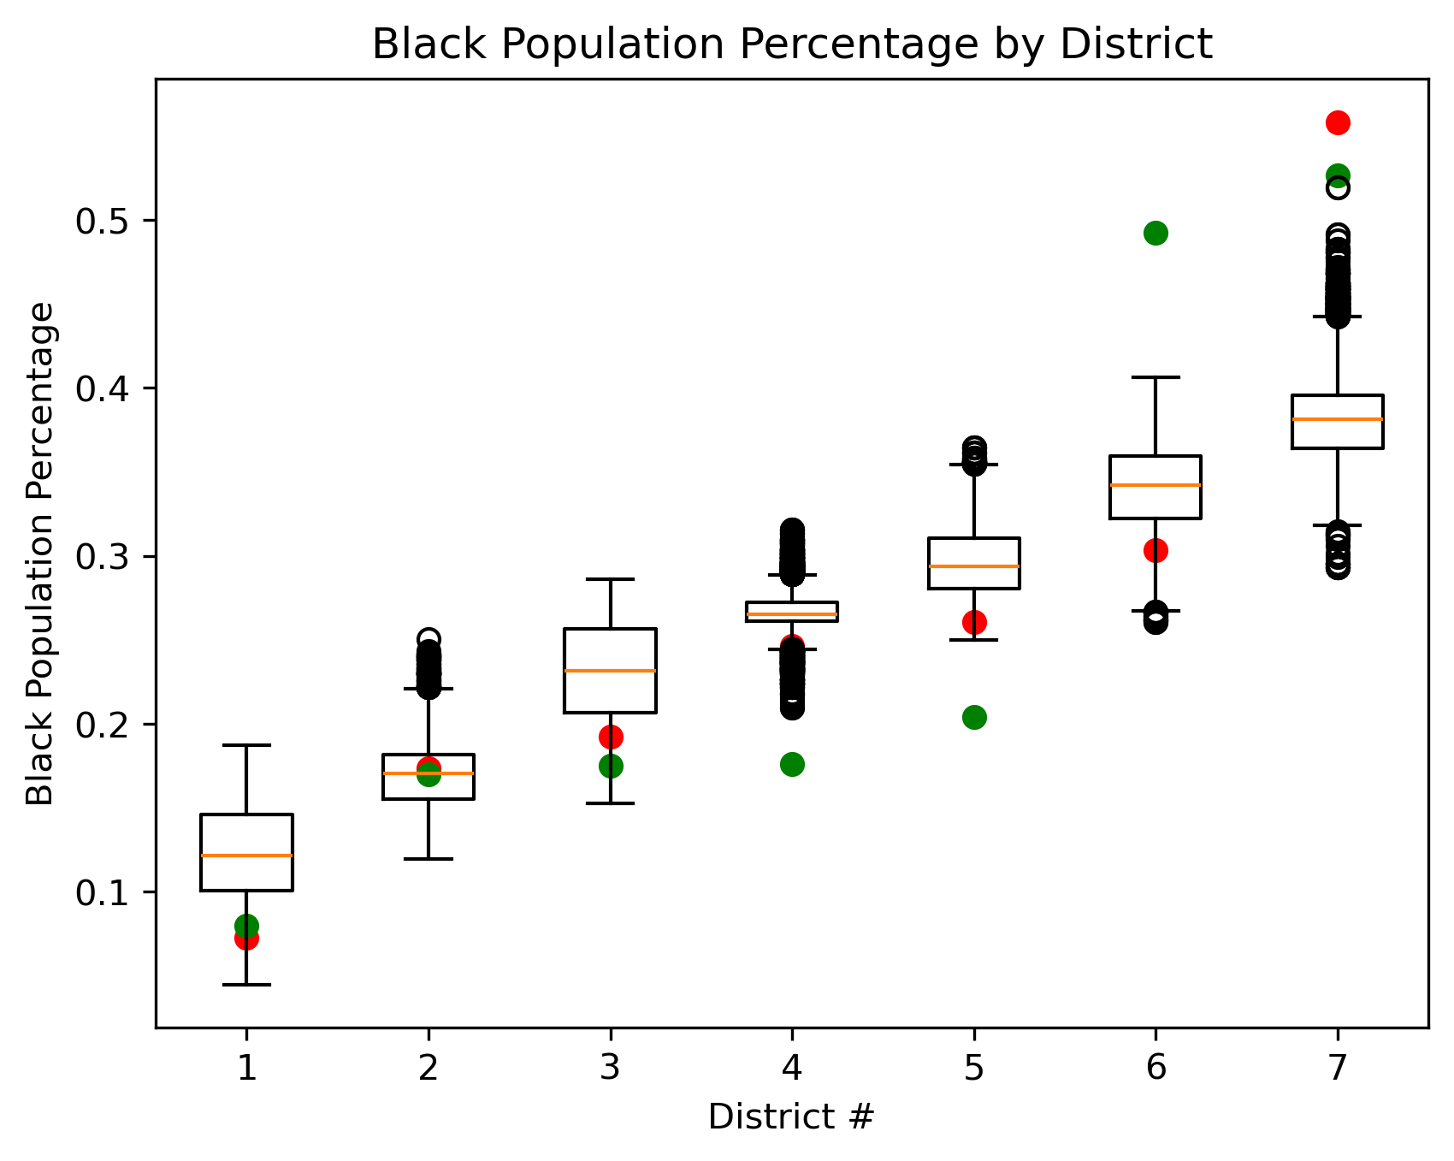
Analysis:
Both plans are very outside the expected in ensemble analysis
Both plans prioritize at least 1 Black-majority district
2024 Plan
2022 Plan

Slide 11
Analysis
Georgia has 13 congressional districts
 | Black majority districts | Democratic majority districts
2022 Plan | 1 | 1
2024 Plan | 2 | 2
Ensemble | 0 | 0

Slide 12
Georgia

Slide 13
Georgia
Initial Congressional Plan was passed in 2021
In Dec 2021, it was challenged as unconstitutional racial gerrymandering
On Oct 2023, the court struck down this map as a violation of the VRA
Gave the state until Dec 2023 to enact a new map
Notes:
Against black voters, diluting their voting strength
Charged to be enacted with racially discriminatory intent

Slide 14
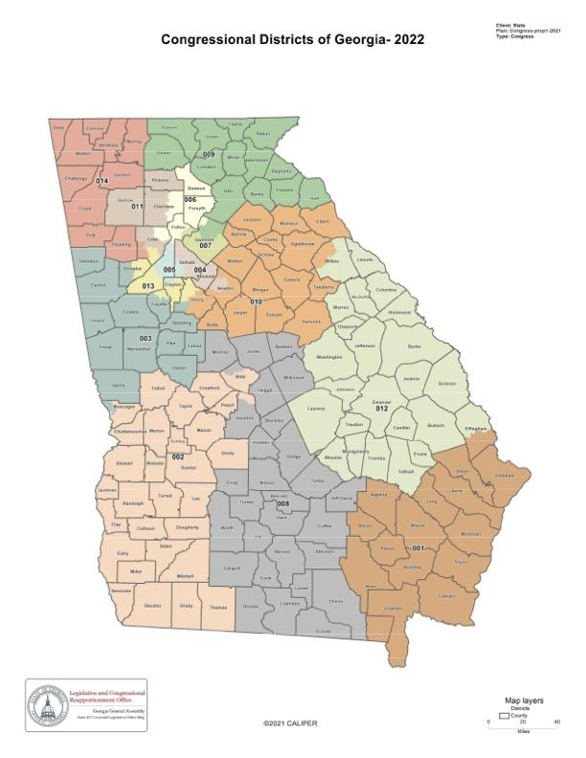
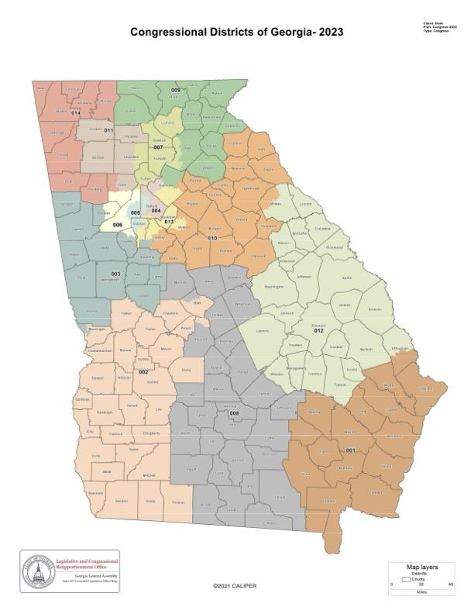
Congressional District Maps
2021
2023

Slide 15
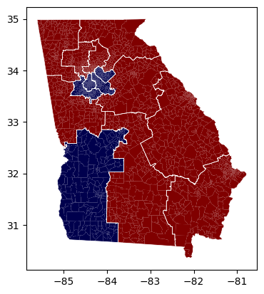

Congressional District Map by Elected Representative
(in 2022 U.S. Senate Runoff Election)
2021
2023

Slide 16
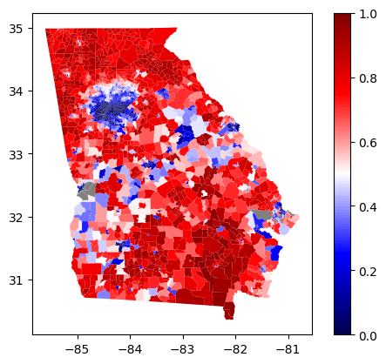
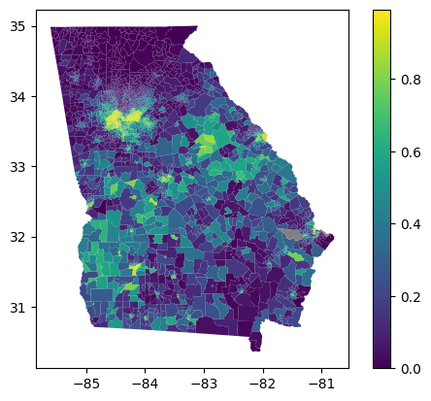
Black Population Percentage by Precinct (2020 Census)
Democrat/Republican Voting Percentage by Precinct
(in 2022 U.S. Senate Runoff Election)

Slide 17
Analysis
Georgia has 13 congressional districts
 | Black majority districts | Democratic majority districts
2021 Plan | 3 | 5
2023 Plan | 4 | 5
Ensemble | 4 or 5 | 6

Slide 18
Arkansas

Slide 19
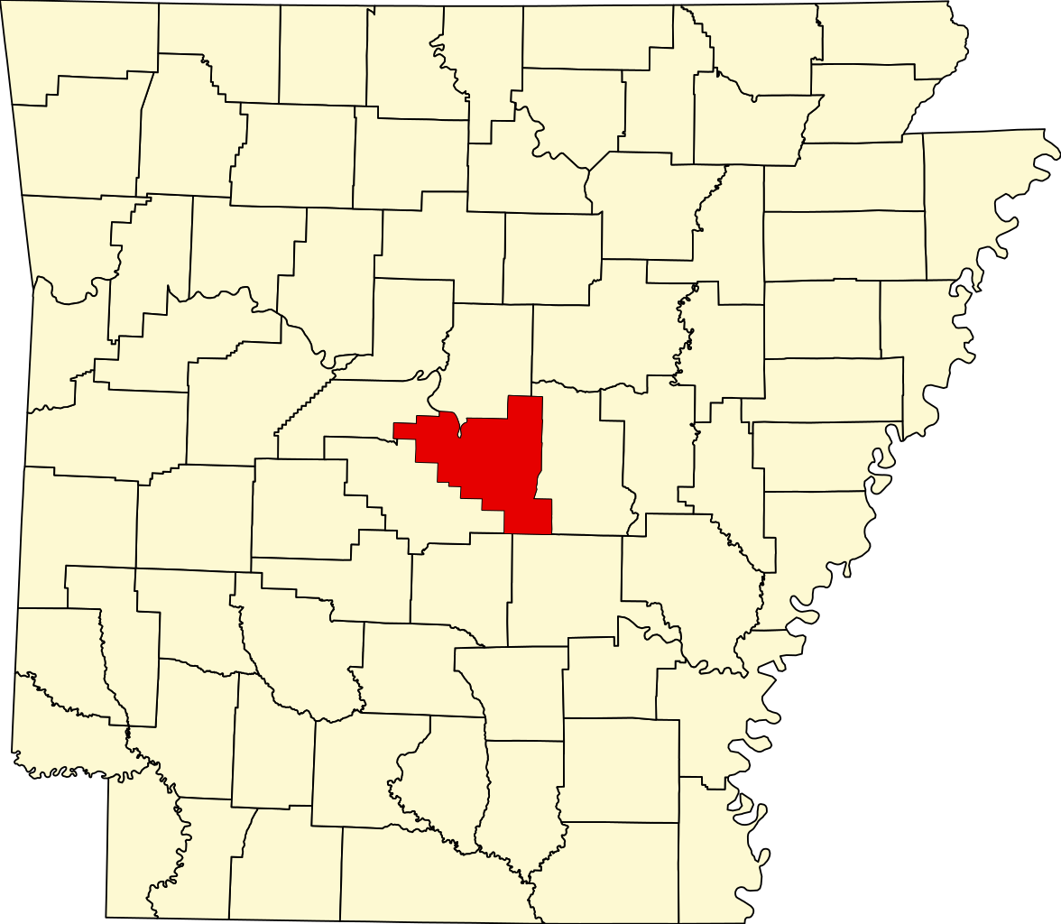
Arkansas
Arkansas sued over splitting the black population in southeast Little Rock (which has ~38% black population in 400,000 people)
Was allowed to use original plan in 2022 and 2024 election

Slide 20
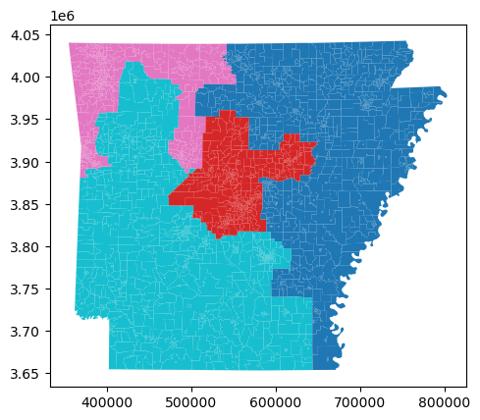
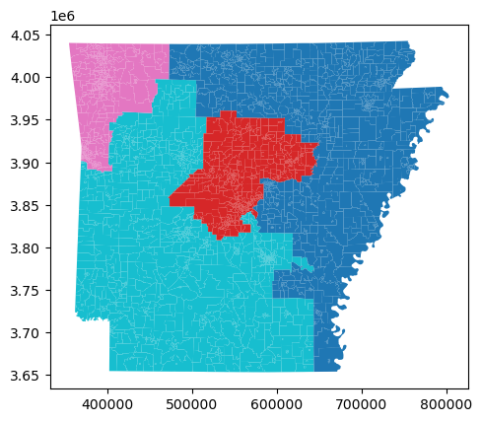
Original Plan (pre-2021)
The Plan in Question (2021)

Slide 21
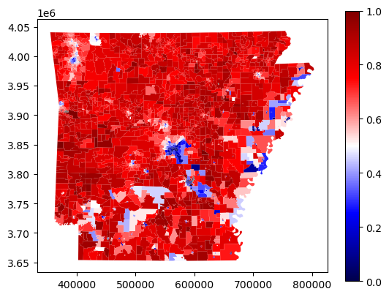
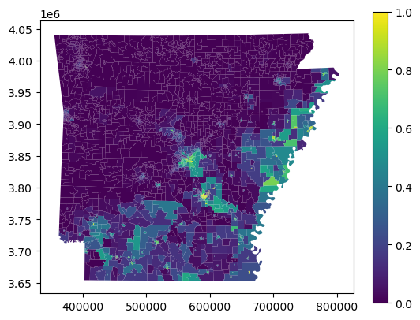
Black Population Percentage by Precinct (2020 Census)
Democrat/Republican Voting Percentage by Precinct
(in 2020 Presidential Election)

Slide 22
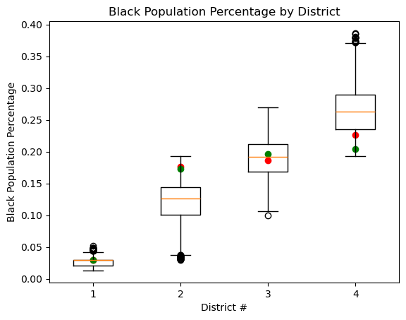
Analysis:
The new plan does have a lower does split the BPOP a little more than the original plan.
However, district #4 is below the most common outcome in both plans.
2021 Plan
2011-2020 Plan

Slide 23
Analysis
Arkansas has 4 congressional districts
 | Black majority districts | Democratic majority districts
Original Plan | 0 | 0
Adopted Plan | 0 | 0
Ensemble | 0 | 0

Slide 24
Texas

Slide 25
Texas
The current plan was passed in October, 2021
From then through November, 2024, multiple challenges of racial discrimination against Black and Hispanic/Latino voters have been issued with no resolution yets

Slide 26
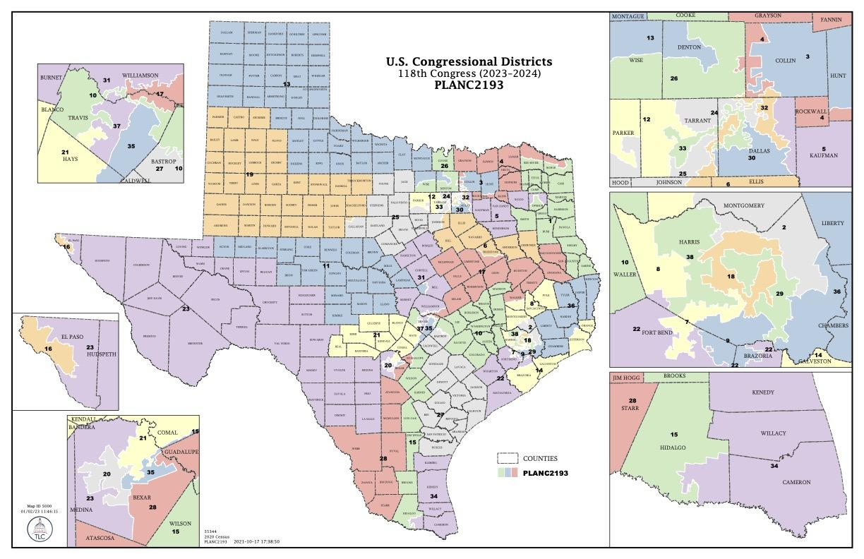
Congressional Districting Map

Slide 27
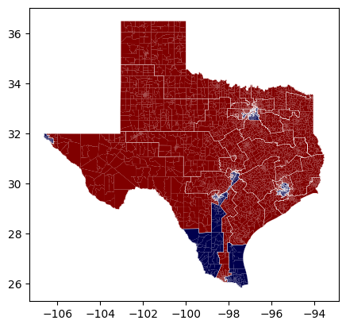
2021 Congressional District Map by Elected Representative
(2020 U.S. Presidential Election)

Slide 28
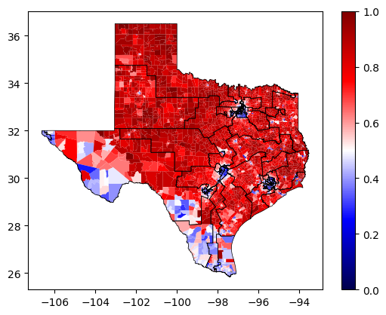
Democrat/Republican Voting Percentage by Precinct
(in 2020 Presidential Election)

Slide 29
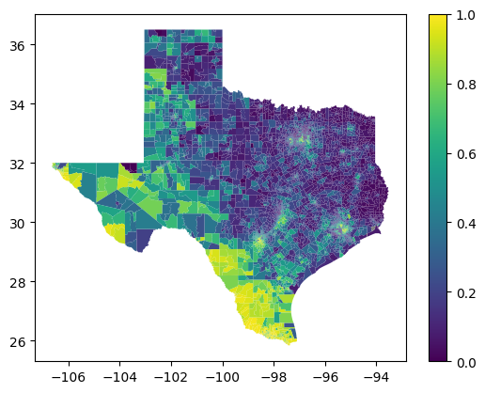
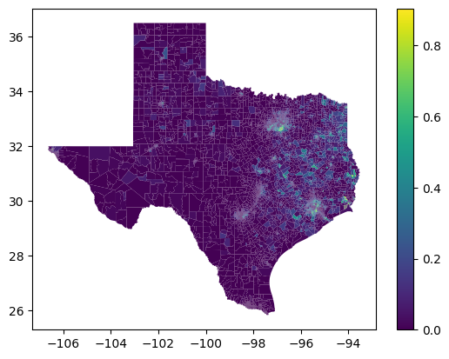
Black Population Percentage by Precinct (2020 Census)
Hispanic Population Percentage by Precinct
(2020 Census)

Slide 30
Analysis
Texas has 38 congressional districts
 | Black majority districts | Hispanic majority districts | Democratic majority districts
2021 Plan | 1 | 14 | 13
Ensemble | 0 | 16 or 17 | 18

Slide 31
Florida

Slide 32
Florida
Legislature created a map (and Secondary map), which was vetoed by the Governor
Governor called a special meeting to create the official map, which cracked Black voters even more than the original two plans.
Case is currently in litigation over being a Racial Gerrymander, violating the Section 2 of the Voting Rights Act

Slide 33
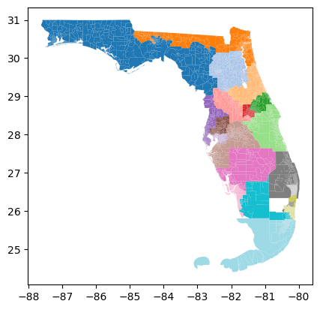
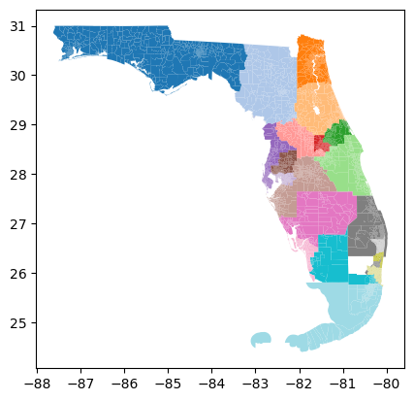
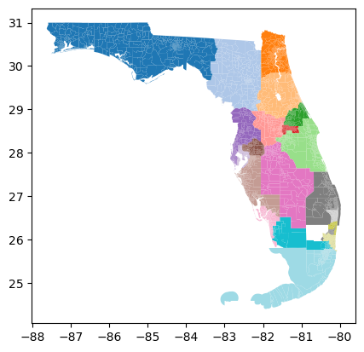
Alternate Plan (not used)
Original Plan (not used)
Revised Plan (2022 & 2024)

Slide 34
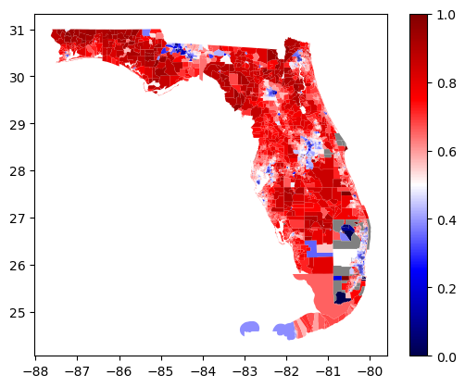
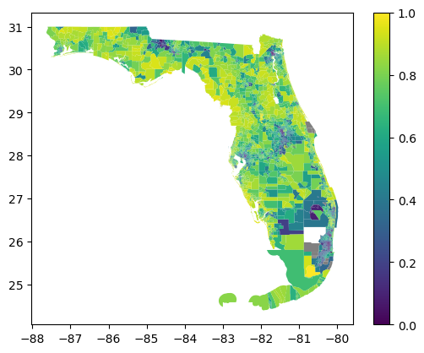
Black Population Percentage by Precinct (2020 Census)
Democrat/Republican Voting Percentage by Precinct
(in 2022 U.S. Senate Election)

Slide 35
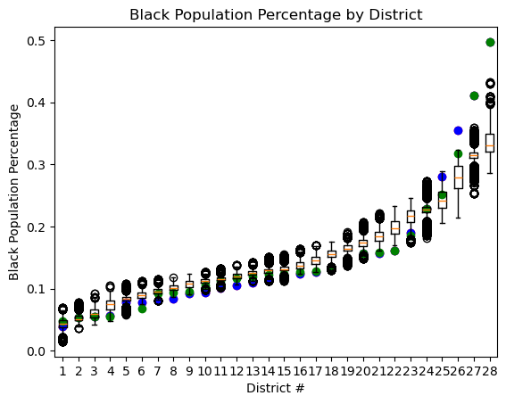
Analysis:
The new plan does seem to keep Black Population percentage below average except for the last two districts, which has one around 40% and one barely above 50%.
However, the ensemble would recommend 0 Black-majority districts.
P000c0109 (used in 2022 and 2024)
H000c8015 (never used)
H000c8019 (never used)

Slide 36
Analysis
Florida has 28 congressional districts
 | Black Majority districts | Democratic Majority Districts
Original Plan (Never Used) | 0 | 8
2022/2024 Plan | 0 | 8
Ensemble | 0 | 7

Slide 37
Utah

Slide 38
Utah
The current plan was passed in November of 2021
In March 2022, it was challenged as a partisan gerrymandering
The Plaintiffs also argued that Utah violated the “Utah Constitution’s citizen lawmaking authority by repealing the redistricting reforms enacted via ballot initiative “Proposition 4,” which included the transfer of redistricting authority to an independent commission and mandatory anti-gerrymandering provisions.”

Slide 39
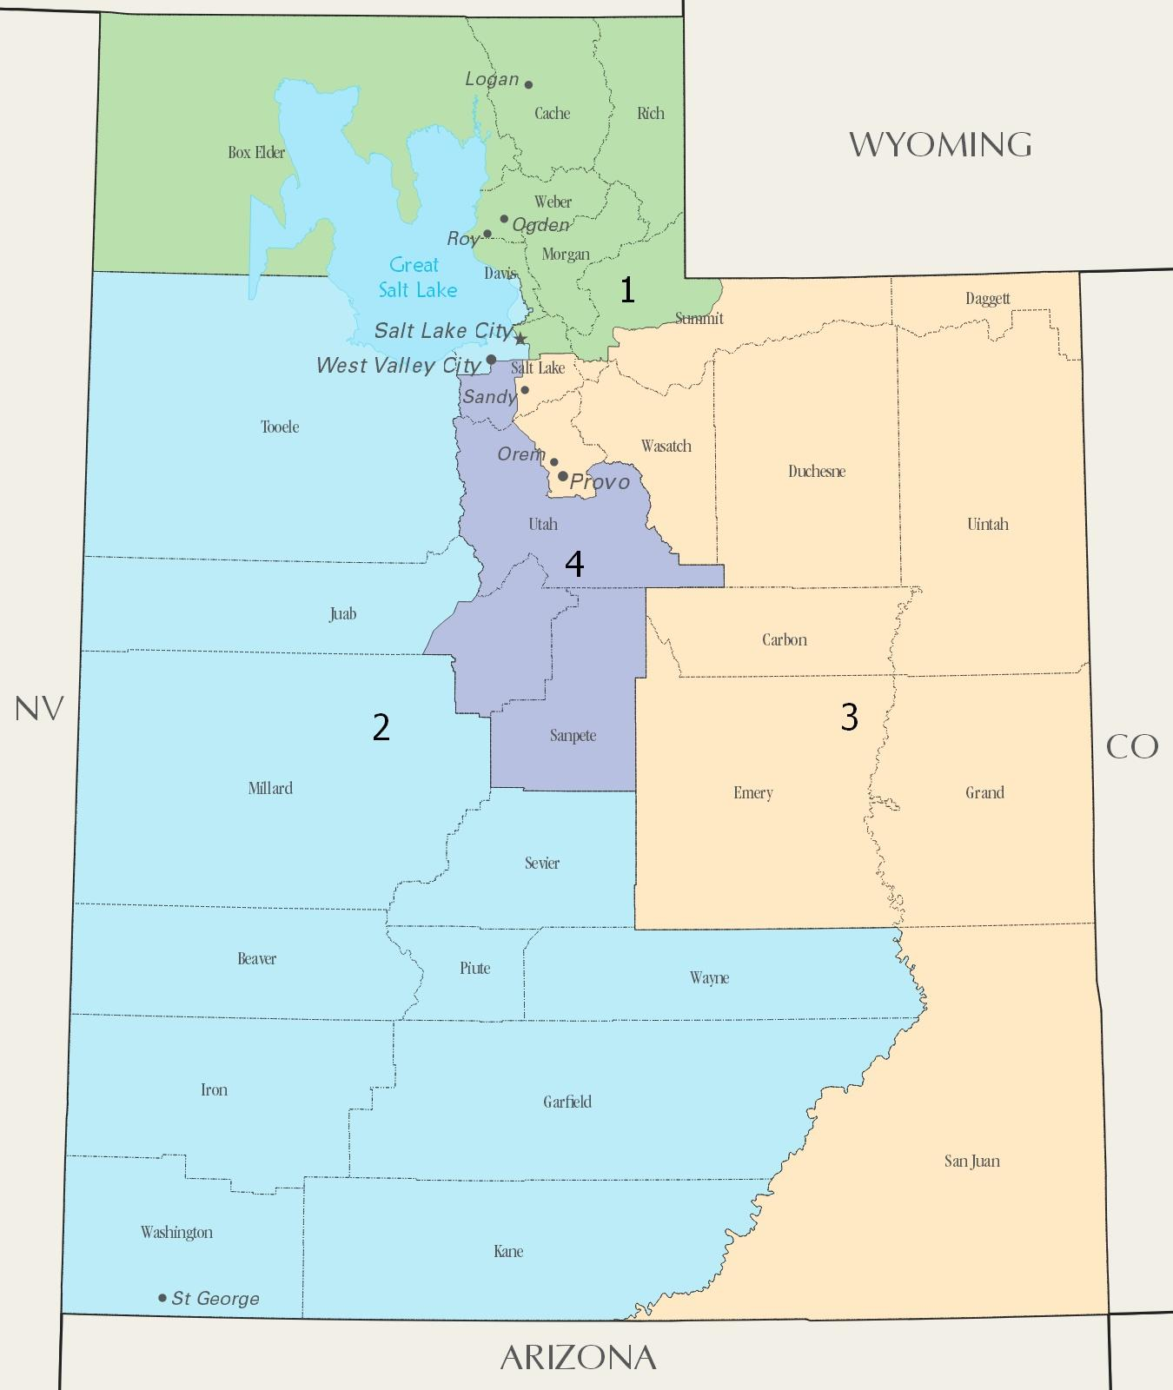
Plan

Slide 40
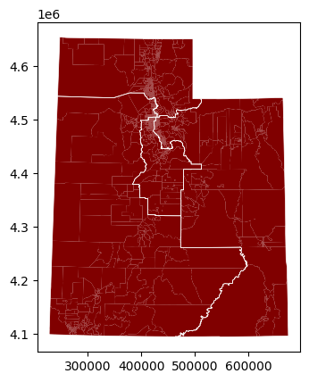
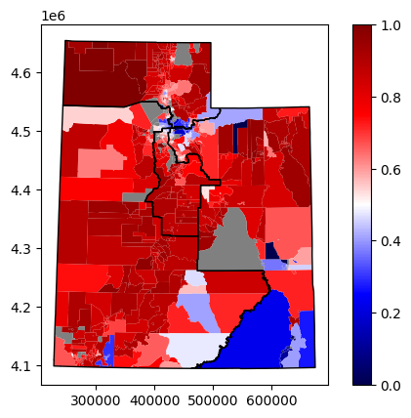
2021 Congressional District Map by Elected Representative
(2020 U.S. Presidential Election)
Democrat/Republican Voting Percentage by Precinct
(in 2020 U.S. Presidential Election)

Slide 41
Analysis
Utah has 4 congressional districts
 | Democratic majority districts
2021 Plan | 0
Ensemble | 1

Slide 42
Louisiana

Slide 43
Louisiana
Originally had one Black-majority district
Taken to court because a second Black-majority district could be formed
Had to make the second district for the Election

Slide 44
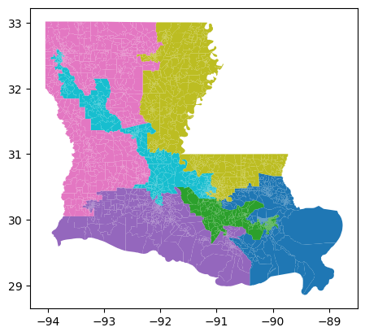
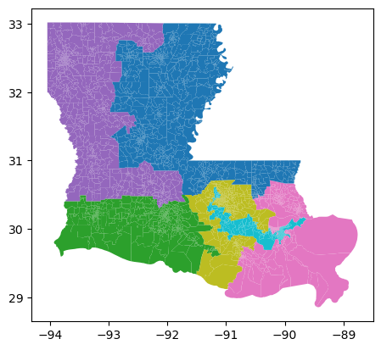
Original Plan (2022)
Adopted Plan (2024)

Slide 45
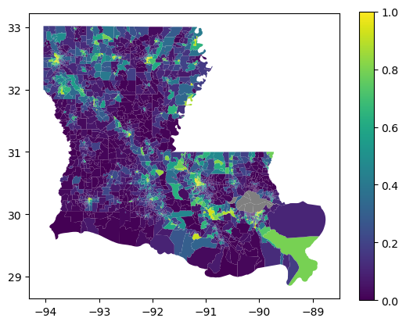
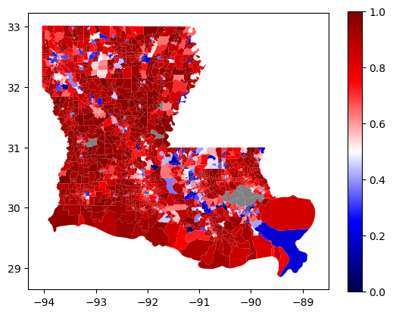
Black Population Percentage by Precinct (2020 Census)
Democrat/Republican Voting Percentage by Precinct
(in 2022 U.S. Senate Election)

Slide 46
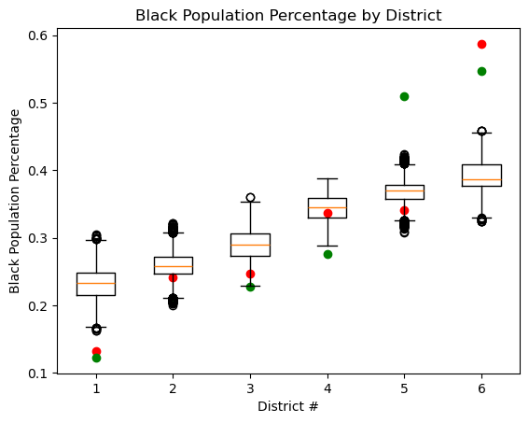
Analysis:
Both the Original and New Plan over-estimate number of Black-Majority districts, but the 2022 plan does show evidence of packing from the #5 to #6.
Ensemble says that no districts should have a Black-Majority
However, could be something missing in our ensemble.
2024 Plan
2022 Plan

Slide 47
Analysis
North Carolina has 14 congressional districts
 | Black Majority Districts | Democratic Majority districts
2022 Plan | 1 | 1
2024 Plan | 2 | 2
Ensemble | 0 | 0

Slide 48
South Carolina

Slide 49
South Carolina
The current plan was passed in 2021
In Oct 2021, S.C. NAACP filed a lawsuit saying Congressional District 1 of the plan was a racial gerrymander. It was dismissed with prejudice Aug 2024.
In July 2024, the lawsuit League of Women Voters of South Carolina v. Thomas Alexander was filed arguing that the current plan is partisan gerrymandering

Slide 50
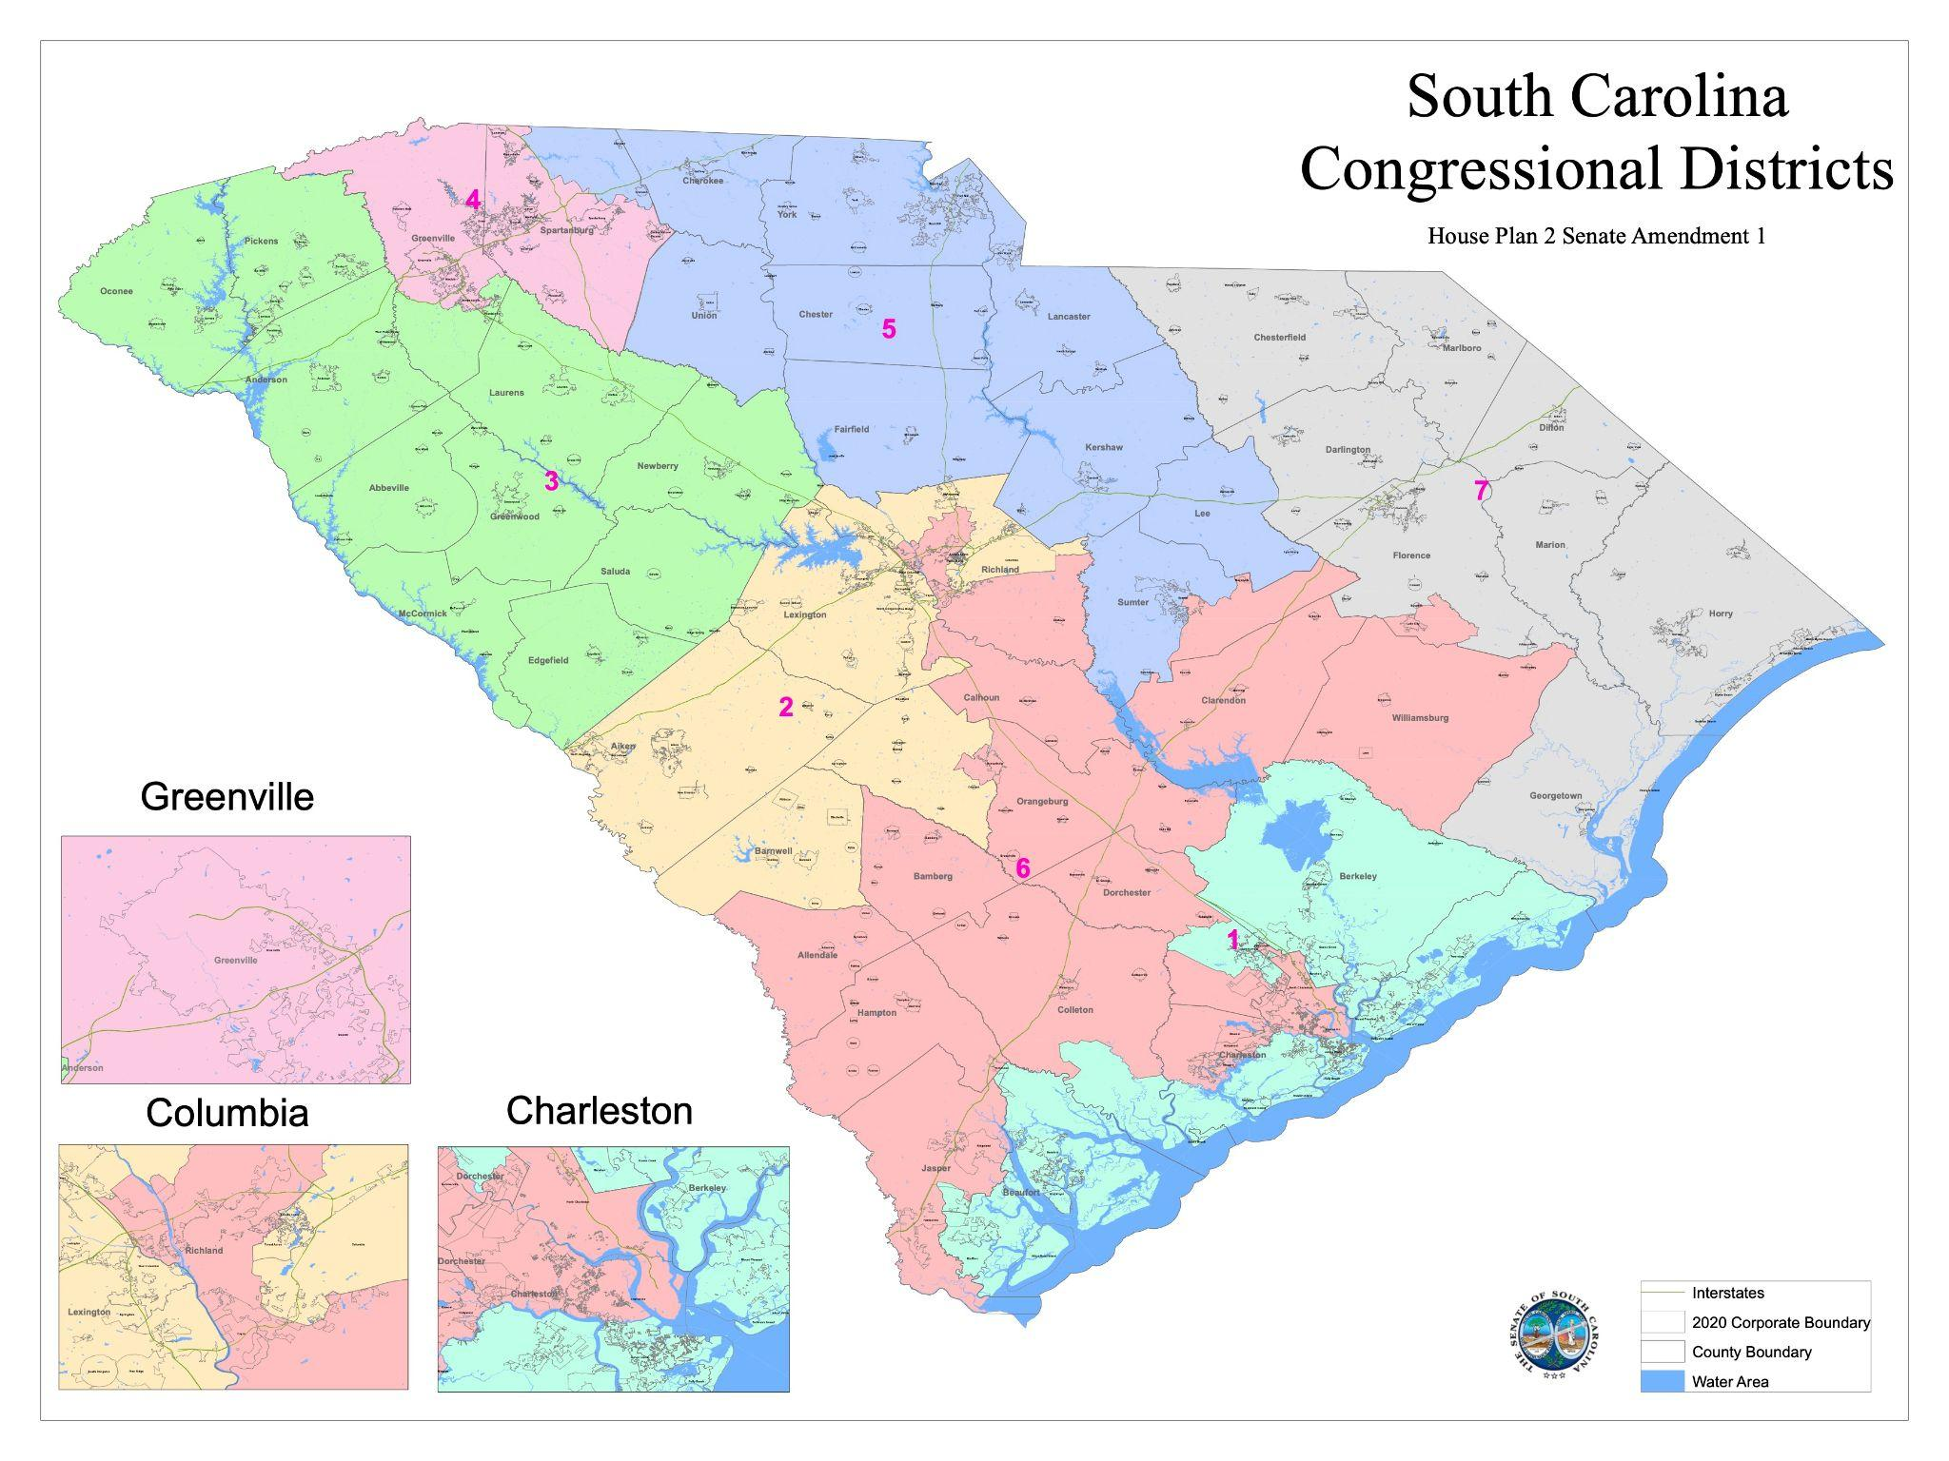
Plan

Slide 51
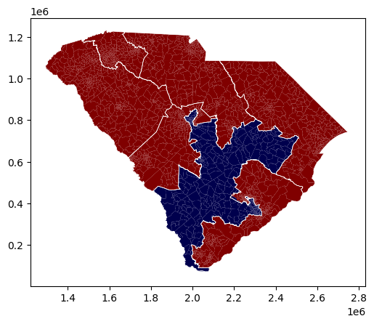
2021 Congressional District Map by Elected Representative
(2022 U.S. Senate Election)

Slide 52
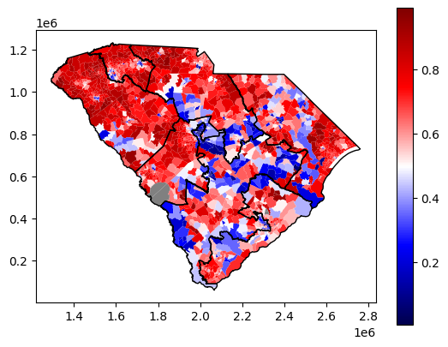
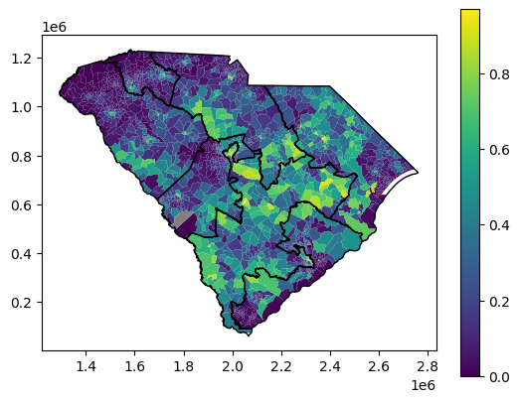
Black Population Percentage by Precinct (2020 Census)
Democrat/Republican Voting Percentage by Precinct
(in 2022 U.S. Senate Election)

Slide 53
Analysis
South Carolina has 7 congressional districts
 | Black majority districts | Democratic majority districts
2021 Plan | 1 | 1
Ensemble | 0 (but 1 is close) | 0

Slide 54
North Carolina

Slide 55
North Carolina
Legislature created a map, which was immediately struck down by State Court
Favored Republicans, cracked Black Voters
Court created a temp plan used in 2022 elections
Legislature redrew the maps for the 2024 elections
Court make-up had changed and ruled that couldn’t challenge map based on partisan fairness

Slide 56
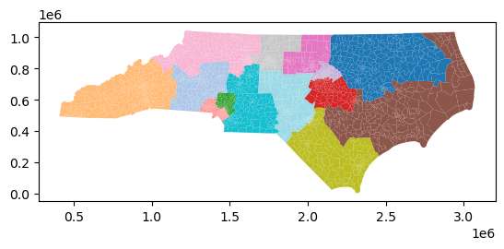
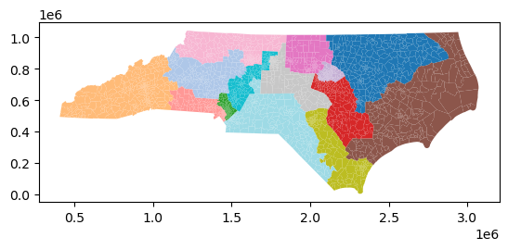
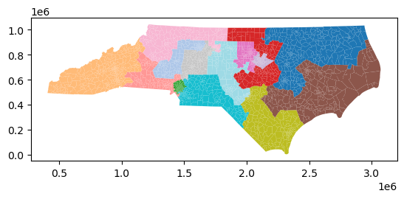
Temp Plan (2022)
Original Plan (not used)
Current Plan (2024)

Slide 57
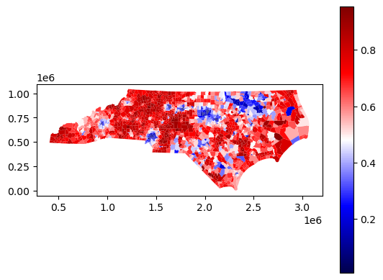
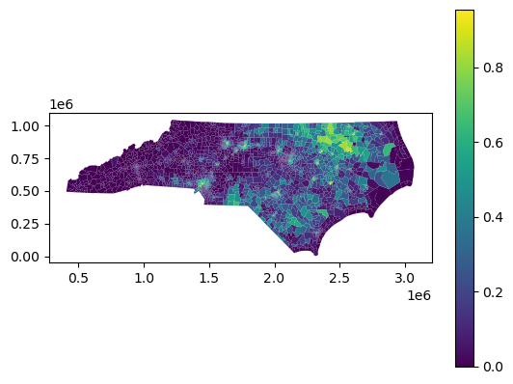
Black Population Percentage by Precinct (2020 Census)
Democrat/Republican Voting Percentage by Precinct
(in 2022 U.S. Senate Election)

Slide 58
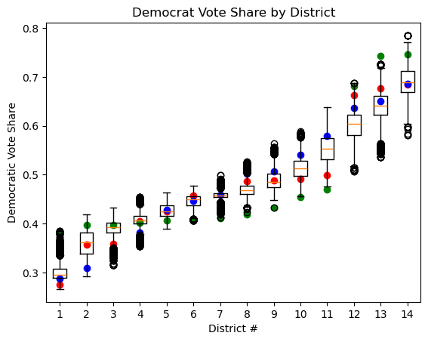
Analysis:
Clearly the Original and Adopted plans dilute Democratic voters
Temporary plan might overly-favor democratic voters
2024 Plan
2022 Plan
Original Plan (never used)

Slide 59
Analysis
North Carolina has 14 congressional districts
 | Democratic majority districts
2020 Plan (Never Used) | 3
2022 Plan (Court) | 7
2024 Plan | 3 (but actual outcome was 4)
Ensemble | 5

Slide 60
Final Analysis & Conclusions

Slide 61
Change Based off of Ensemble Analysis
 | Districts | Change
Alabama | 7 | -2 D / +2 R
Georgia | 14 | +1 D / -1 R
Arkansas | 4 | +0 D / -0 R
Texas | 38 | +5 D / -5 R
Florida | 28 | -1 D / +1 R
Utah | 4 | +1 D / -1 R
Louisiana | 6 | -1 D / +1 R
South Carolina | 7 | +0 D / -0 R
North Carolina | 14 | +1 D / -1 R

Slide 62
Actual Election
Proxy Election
Republicans: 220 seats
Democrats: 215 seats
Republicans: (220-4) = 216 seats
Democrats: (215+4) = 219 seats
Notes:
Need 218 for a majority

Slide 63
Our (bold) conclusion:
According to our Ensemble Analysis, Democrats might have won the House in the 2024 election. However, this assumes that our ensemble analysis had all the information, which is unlikely.

Slide 64
Additional Works Cited
https://www.theguardian.com/us-news/2024/dec/04/democrat-adam-gray-wins-california-house-election-against-republican-john-duarte

